Slide 1
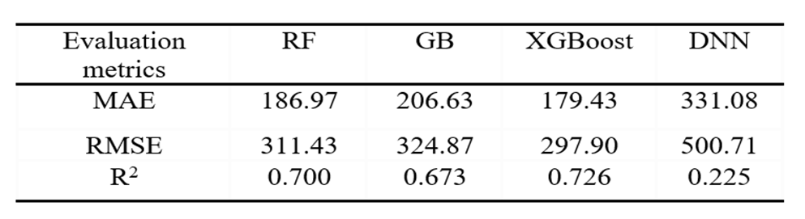
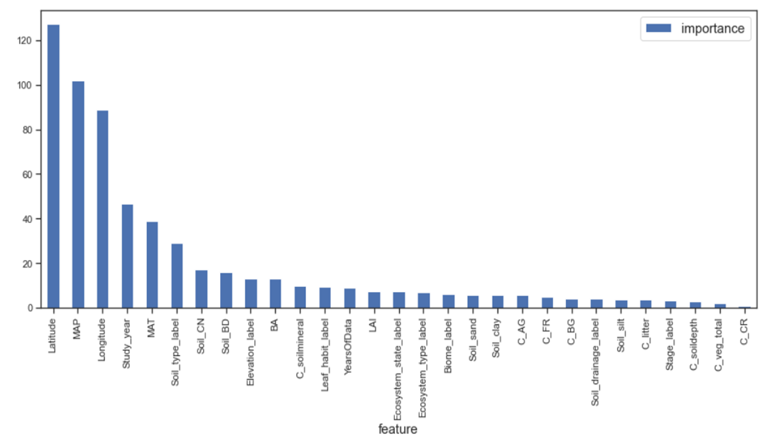
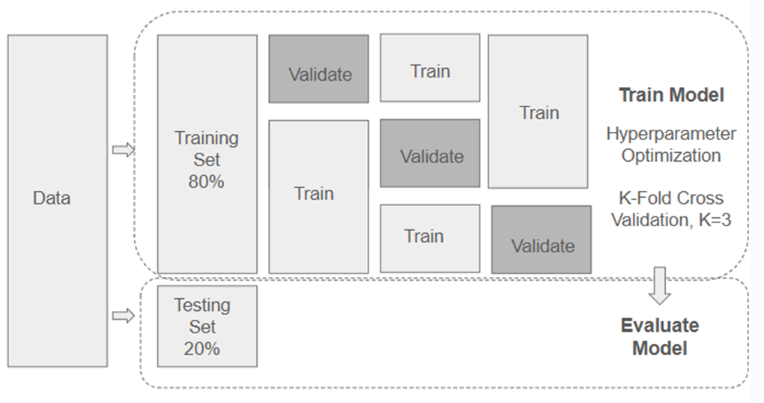
Exploring Innovative Machine Learning Models for Soil CO₂ Emission Forecasting
Vincent Lu, Basis Independent Fremont, Fremont, CA, USA
ID: 6736
Q3: Data Analysis and Results
Q1: Research Question
How can AI/machine learning framework help us accurately predict CO₂ emissions from soil respiration based on spatial, temporal, climatic, and other observable variables?
Can AI/machine learning help us understand the environmental drivers behind soil respiration process?
Model Performance Comparison
XGBoost model has the best performance in terms of predictive accuracy and error reduction compared with the other three models:
Lowest MAE and RMSE
Highest R2
SHAP analysis reveals that Mean Annual Temperature (MAT) and Mean Annual Precipitation (MAP) are the most influential environmental factors, alongside geographic features such as latitude and longitude, aligning with previous studies.
Q2: Methodology
Model selection:
Proposed Model: XGBoost;
Baseline models: Random Forest (RF), Gradient Boosting (GB)
Hyperparameter optimization:
GridSearchCV with K-fold cross-validation.
Q4: Interpretation and Conclusions
An innovative ensemble model, XGBoost, is developed to predict annual Rs from spatial, temporal, climate, and other independent variables. The XGBoost model delivers the best performance, achieving a 4% reduction in MAE and RMSE and a 3.7% improvement in R2 compared to the Random Forest model, previously identified as the top-performing approach.
SHAP (SHapley Additive exPlanations) is employed as a robust method for model explainability, enabling the assessment of feature impacts on predictions both globally and at the individual observation level.

